Slide 1
West Coast Air Adventures
The Past, Present and Future Developments

Slide 2
Background
WCAA, established in 1989, is a highly successful company, operating flights to the major West Coast tourists areas.
Both fixed wing and helicopter flights are on offer.
A recent accident due to poor weather conditions has hit customer confidence.
We have felt this with a drop in the number of bookings.
Focus groups revealed that customers wanted package holiday deals. These packages would include sightseeing, hotel accommodation and travel.
In an attempt to regain income and confidence, a solution from inside the company was sought.
Notes:
Customers are satisfied with five nines reliability. To warrant a new implementation VoIP must provide a BETTER service.
A majority of interest in the phone networks relates to voice traffic, and as such VoIP needs to provide an equal quality, equal reliability service.
There is room in the market for lower reliability and quality services such as skype, where users a willing to trade these attributes for a cost benefit.
But we are focusing on Service providers, so shall selectively ignore this market.

Slide 3
Project Choice
All the stakeholders were included in the decision making process, which involved evaluating each project against a set of company objectives.
These objectives were:
  Value for money
  Improve safety
  Improve public image
  Forms a complete holiday package
  Keeps the company commercially viable
It was decided that the website would be the best project.
The website was seen as good way to incorporate the businesses goals into an easy-to-access portal.

Slide 4

Justification for taking on project
Ideas for projects were:
  Enter a partnership with a coach company to purchase hotels
    Having a partnership will make for seamless, trouble-free travel, and more capital funds.
  Develop a company website
    This will gives us face to both national and international visitors and provide a way to get more information and book holidays.
  Computer equipment upgrade
    Investing in a computer network will enable better control over aircraft maintenance, payroll and asset management.
  Aeronautical navigational systems upgrade
    By installing GPS systems and sophisticated radar, the likelihood of an accident is dramatically decreased.

Slide 5
Project Scope
The website requirements were defined in consultation with all stakeholders.
The requirements were:
  Allow customers to gain information and book holiday packages.
  Have a secure booking system.
  The website must look professional, professional and trustworthy
  It must be fast loading and be fully standards-compliant
  Be hosted in a scalable and 'always on' environment
  Be accessible for people with disabilities
  Have a contact us feature so customers can get more information
  Have a fast and accurate search function.
  Encourage tourists to book package holidays

Slide 6

WBS and schedule
WBS
  Initiating
      Project manager / stakeholder meeting / business case
  Planning
    Scope statement / WBS / Gantt chart / outsourcing
  Executing
    Information gathering / website design & implementation
  Controlling
    Regular status reports / change control procedure
  Closing
    Lessons learned / official handover
Schedule
  12 months from conception to finished product

Slide 7
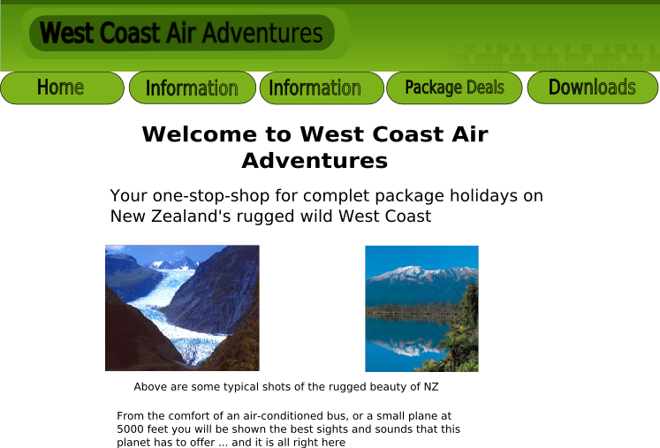
Website design

Slide 8
Change
Managed by strict change control procedure
  Change control request form
  Signed by all parties involved with change
    Result: Smooth change where everybody was on the same page.
Major change:
  Release of West Coast tourism video
  Released in DVD and direct download
  Change in scope, cost, schedule and technology
Used a PMIS on intranet
  Central place for notices where everybody would see them
    Kept everybody up to date with progress

Slide 9
Present and Future Developments
We have not seen the rapid growth in bookings due to the site that we predicted.
However, there is a large amount of traffic, mainly from USA and UK.
We are still confident that within 1 year we will see a 50% increase in overseas bookings.
We are working with search engines to try and get out site higher on certain queries.
The download version of the video is not as popular as anticipated.
  Due to large file size and our slow connection speed.
  Currently looking at hosting it overseas

Slide 10
User feedback
Initial feedback from customers is very promising
We are getting emails from customers asking for extra information.
  We are looking at incorporating these questions and answers either into a FAQ or merging with current information.
We have been doing some research with focus groups
  Very good general layout and features easy to use.
  Booking system easy to use and seems trustworthy from their point-of-view.
  The video on DVD appeals much more than downloadable version.
  Want more information about the package deals themselves rather than the individual sightseeing visits.

